Slide 1
Business Process Engineering
Sobia.Iftikhar@nu.edu.pk Week 04

Slide 2
Business-to-Business Processes
The business motivation behind interacting business processes stems from value systems, which represent collaborations between the value chains of multiple companies.
These high-level collaborations are realized by interacting business processes, each of which is run by one company in a business to business process scenario.

Slide 3
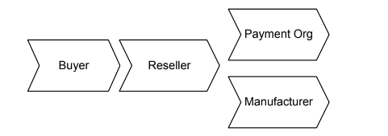
Business-to-Business Processes
A buyer orders goods from a reseller, who acts as an intermediary.
The reseller sends a respective product request to a manufacturer, who delivers to product to the buyer. In addition, the reseller asks a payment organization to take care of the billing.

Slide 4
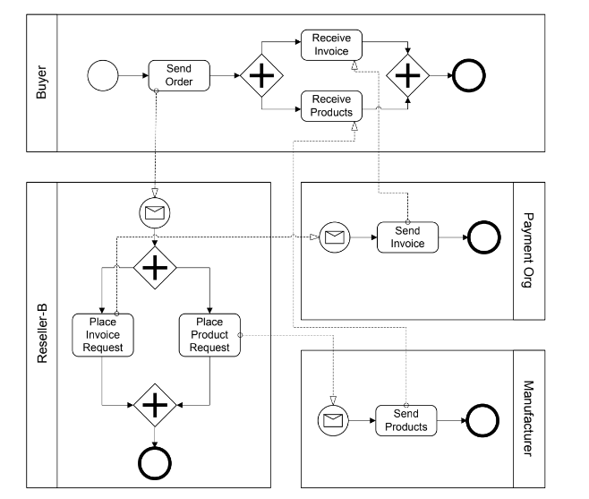
Example of business-to-business collaboration through interacting busi- ness processes

Slide 5
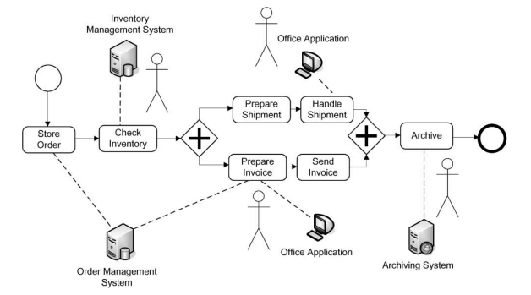
Business-to-Business Processes
Workflows in which humans are actively involved and interact with information systems are called human interaction workflows.

Slide 6
Business-to-Business Processes
Enterprise Services Computing
A service captures functionality with a business value that is ready to be used.
Services are made available by service providers.
A service requires a service description that can be accessed and understood by potential service requestors.
Software services are services that are realized by software systems.
Consider a real-world service, for example, one to fix a car. The service the garage provides needs to be specified in a way that the customer can find and use. Once the car is fixed, the customer pays the bill and the service is completed.

Slide 7
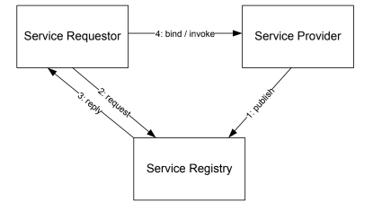
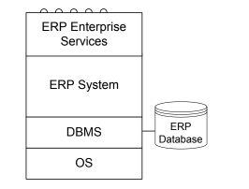
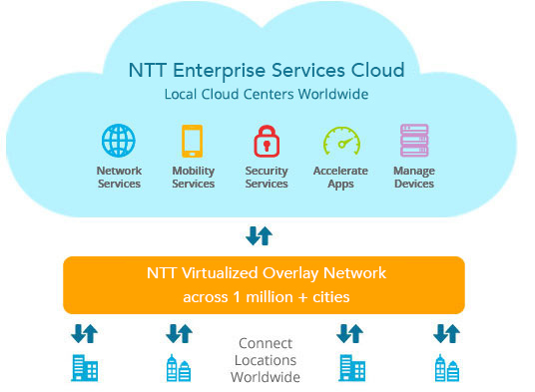
Business-to-Business Processes
Enterprise Services Computing
Service Oriented Architecture
Enterprise Services
functionality of application systems can be described and provided by services.

Slide 8
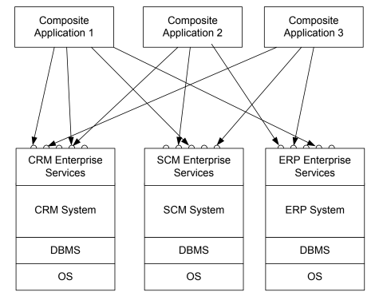
Business-to-Business Processes
Composite Application
With this background in enterprise services architectures, an intra-company
scenario is sketched, where new applications should be built on top of an existing customer relationship management system, a supply chain management system, and an enterprise resource planning system. These systems expose enterprise services via standardized interfaces. The applications built on top are known as composite applications,

Slide 9
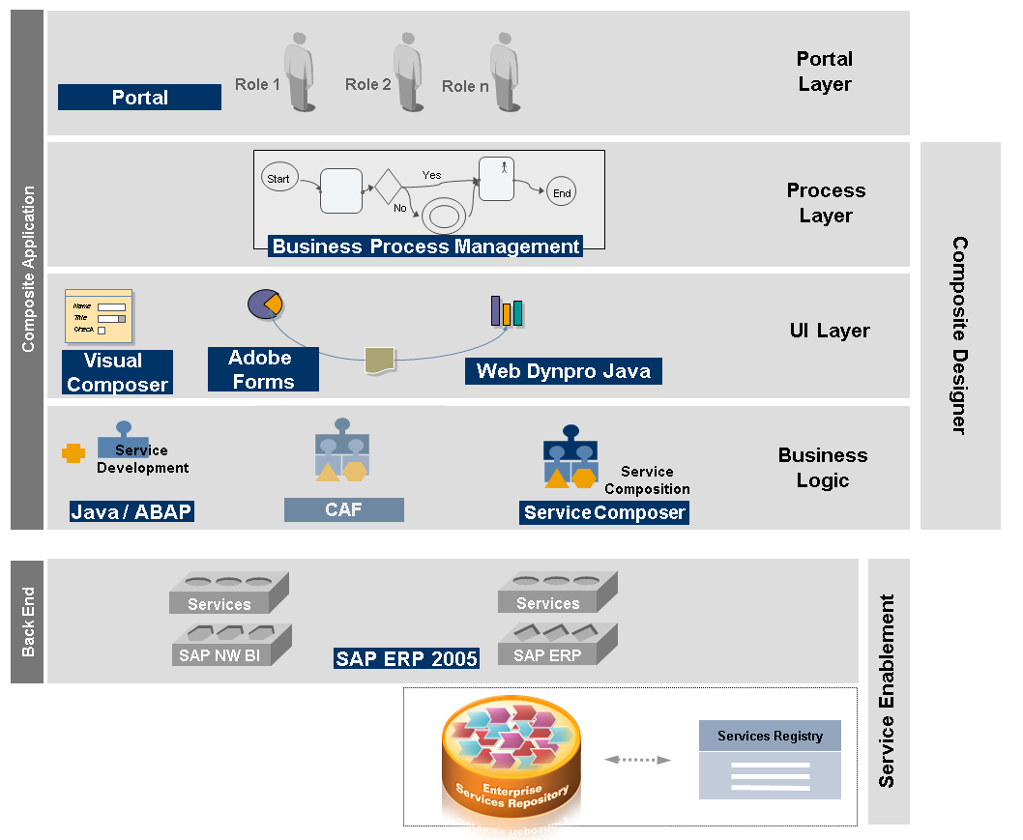

Slide 10
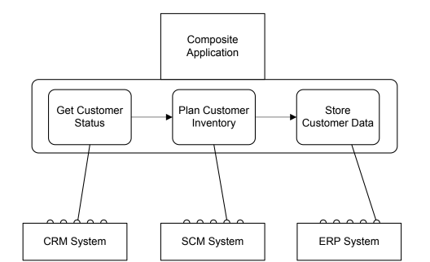
Service Composition
Using service composition to realize composite applications

Slide 11
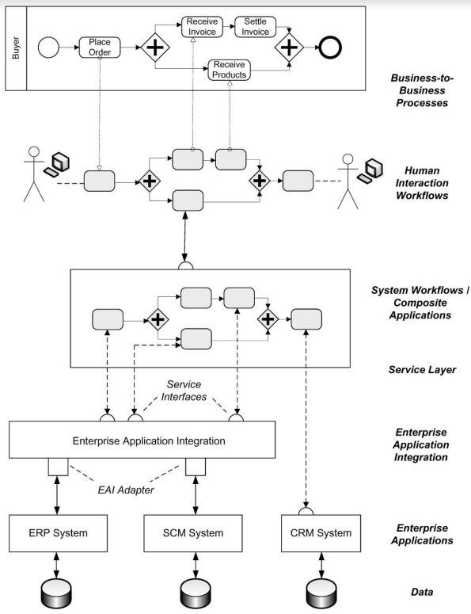
Business process management landscape
Workflow Management Coalition defines workflows and workflow management
systems as follows.

Slide 12
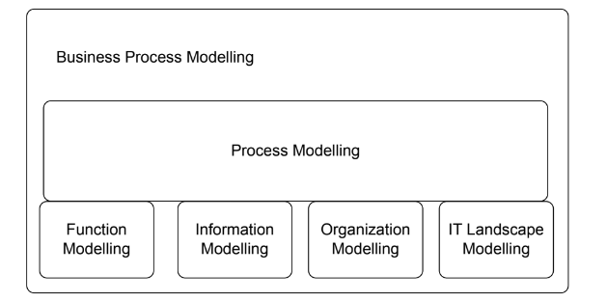
Business Process Modeling
Function modelling, data modelling, organization modelling, and modelling of the operational information technology landscape are required to
provide a complete picture of a business process.

Slide 13
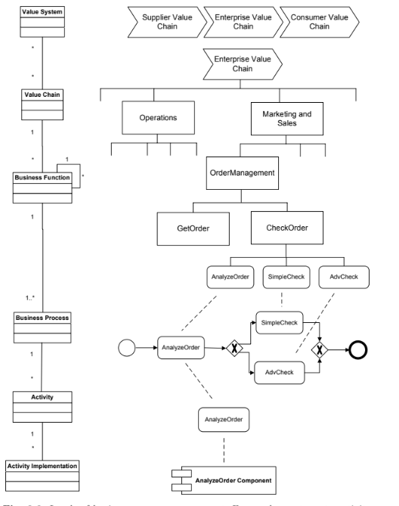
Activity Models and Activity Instances

Slide 14
Business Process Modeling
Conceptual Model:
Business processes consist of activities whose coordinated execution realizes some business goal. These activities can be:
system activities
user inter-action activities
manual activities.

Slide 15
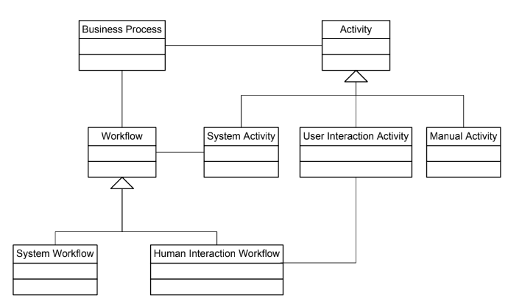
Conceptual Model
Manual Activity
manual activity is sending a parcel to a business partner. Manual activities are not supported by information systems.
User Interaction Activity
human interaction activity is entering data on an insurance claim in a call center environment. There is no physical activity involved.
System Activity
System activities do not involve a human user; they are executed by in-formation systems. An example of a system activity is retrieving stock in formation from a stock broker application or checking the balance of a bank account. It

Slide 16
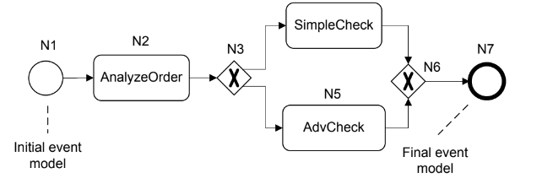
Business Process Modeling Notation:
• Event model nodes are represented by circles; the final event model is represented by a bold circle.
• Activity models are represented by rectangles with rounded edges.
• Gateway models are represented by diamonds.
• Edges are represented by directed edges between nodes.

Slide 17
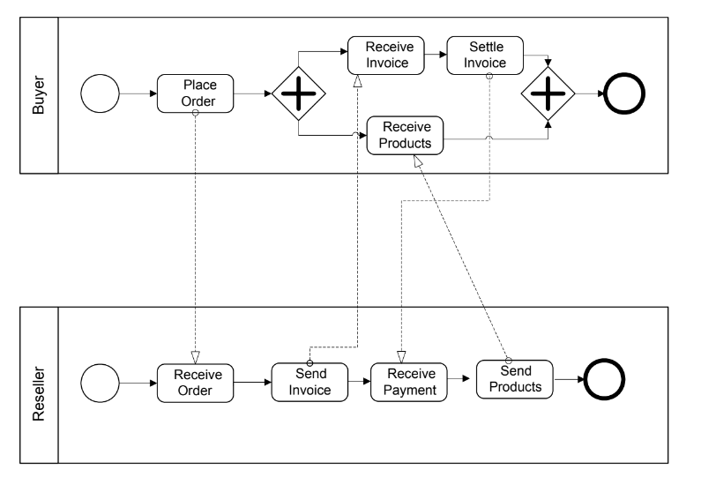
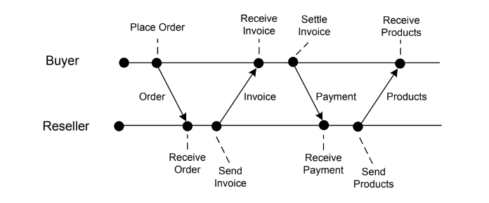
Process Interactions
Event diagram of interacting processes shown
Interacting business processes involving buyer and reseller

Slide 18
Modelling Process Data
Business processes operate on data.
Explicitly representing data, data types, and data dependencies between activities of a business process puts a business process management system in a position to control the transfer of relevant data as generated and processed during processes enactment.

Slide 19
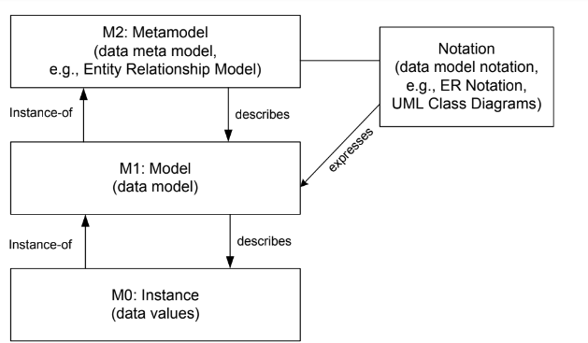
Modelling Process Data
Modelling Data:
Data modelling is at the core of database design.
The Entity Relationship approach is used to classify and organize data in a given application domain.
In a modelling effort, the most important entities are identified and classified.
orders, customers, and products are among the entities of the real world that need to be represented in the data model.
Properties of the entities (Oder nu, price, quantity)
Metamodel level

Slide 20
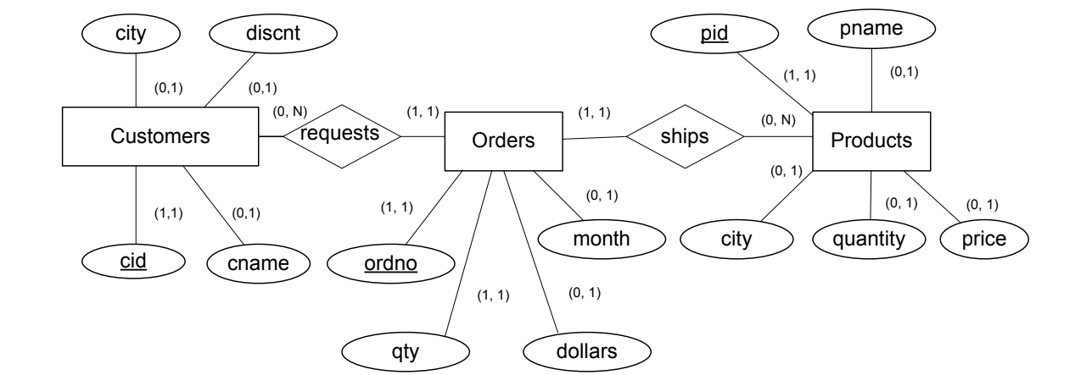
Modelling Process Data
Modeling Data (ERD)
In Entity Relationship diagrams, relationship types are typically represented by diamond symbols,

Slide 21
Workflow Data Patterns
To organize data-related issues in business process management, workflow data patterns have been introduced.
Purpose: how to handle data in business processes.
They are organized according to the dimensions:
data visibility
data interaction
data transfer
data-based routing.

Slide 22
Workflow Data Patterns
Data Visibility
The most important workflow data patterns regarding
data visibility are as follows.
Task data: The data object is local to a particular activity; it is not visible to other activities of the same process or other processes.
Eg: The working trajectory variable is only used within the Calculate Flight Path task.
Block data: The data object is visible to all activities of a given subprocess.
Workflow data: The data object is visible to all activities of a given business process, but access is restricted by the business process management system, as defined in the business process model.
Environment data: Data elements which exist in the external operating environment are able to be accessed by components of processes during execution.

Slide 23
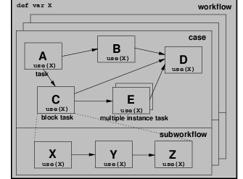
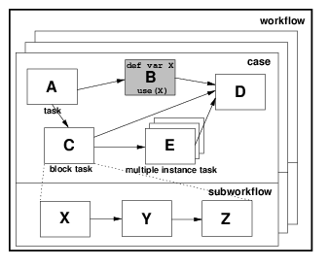
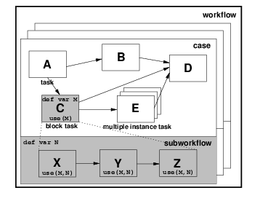
Workflow Data Patterns
The risk/premium matrix can be utilised by all of the cases of the Write Insurance Policy workflow and all tasks within each case.
The working trajectory variable is only used within the Calculate Flight Path task.
All components of the sub process which define the Assess Investment Risk block task can utilize the security details data element.

Slide 24
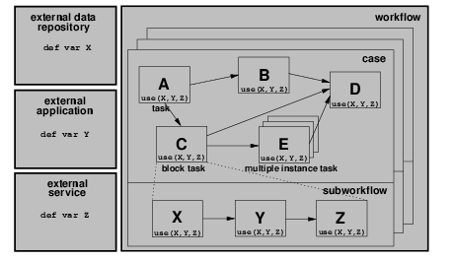
Workflow Data Patterns
Data elements which exist in the external operating environment are able to be accessed by components of processes during execution.

Slide 25
Workflow Data Patterns
Data interaction patterns: Data can also be communicated between the business process and the business process management system.
Data Transfer: These data transfer patterns are very similar to call-by-value and call- by-reference, concepts used in programming languages to invoke procedures and functions.
Data base routing: data can have different implications on process enactment. In the simplest case, the presence of a data object can enable a process activity. Data objects can also be used to evaluate conditions in business process models, for instance, to decide on the particular branch to take in a split node.

Slide 26
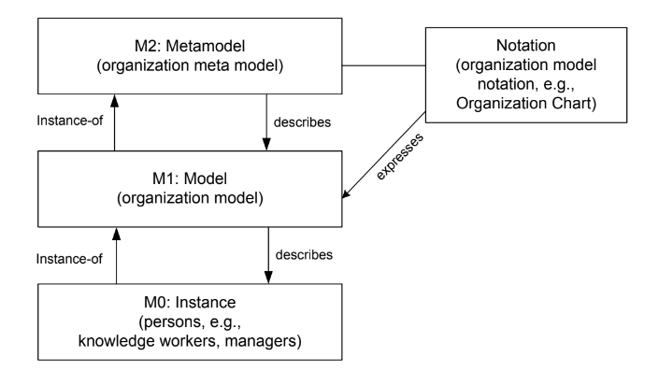
Modelling Organization
Persons are part of an organization, typically a business organization. The persons in these organizations work to fulfil the business goals of the enterprise. Each person typically occupies some position, and the duties and privileges of that person come with the position, not with the person.

Slide 27
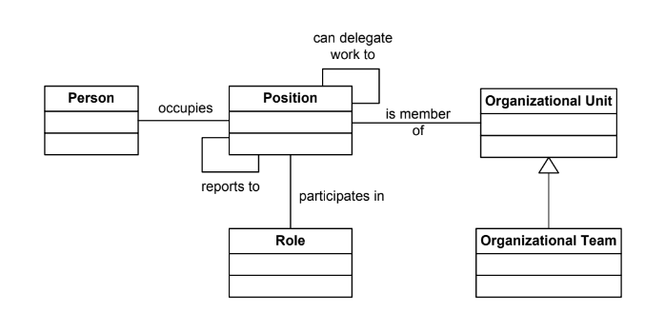
Modelling Organization
Organization metamodel

Slide 28
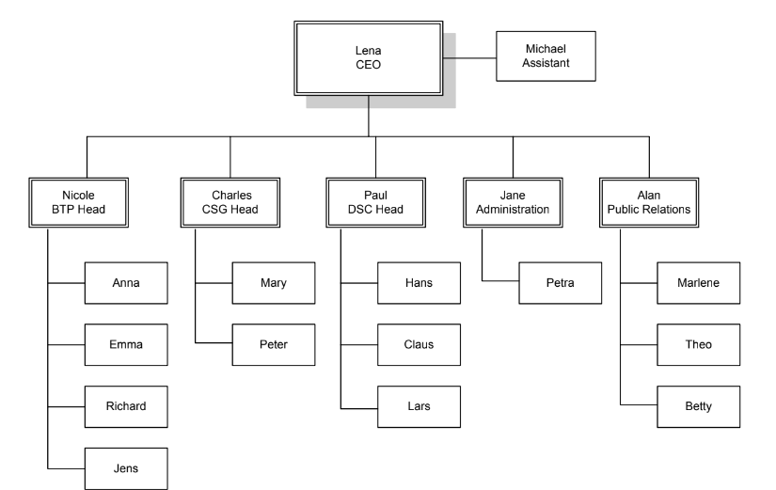
Modelling Organization
Sample organizational chart

Slide 29
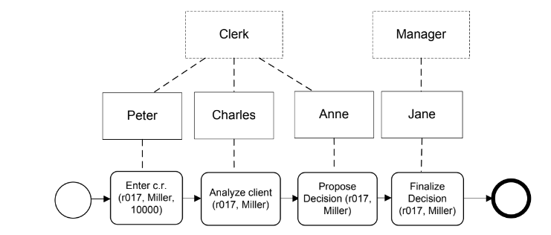
Modelling Organization
Roll Information

Slide 30
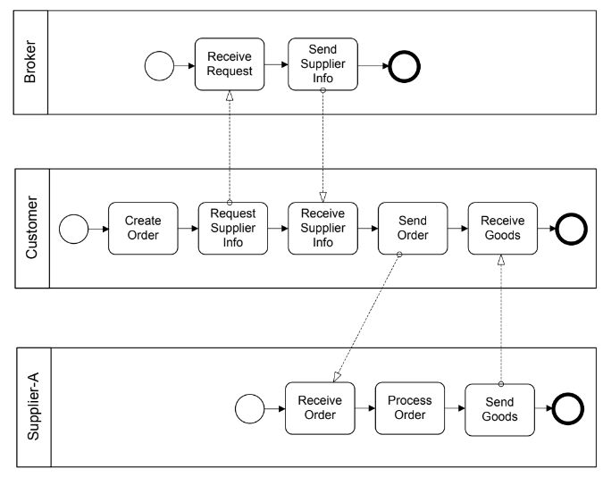
Selection of Business Partners in Process Choreographies
Consider a business process choreography with multiple business partners, each of which plays a specific role in the choreography. If there is a role Shipper specified according to the requirements for shipping goods, it can be bound to specific enterprises that can perform the work.

Slide 31
Public vs. Private Processes
Often multiple agencies (organisations, companies) cooperate, e.g.
Classical purchasing scenarios with customer, retailer and transporter
Partnership where different partners with their resources and know how contribute to a service or product
In this case we can distinguish between public and private processes
Public Process: coordinates work between partners
describes the inter-organisational cooperation
internal processes of the partners are treated as "black boxes"
Specifies the information and objects that are exchanges between partners
Private Process: Process within one organisation
Destailed process flow for each partner

Slide 32
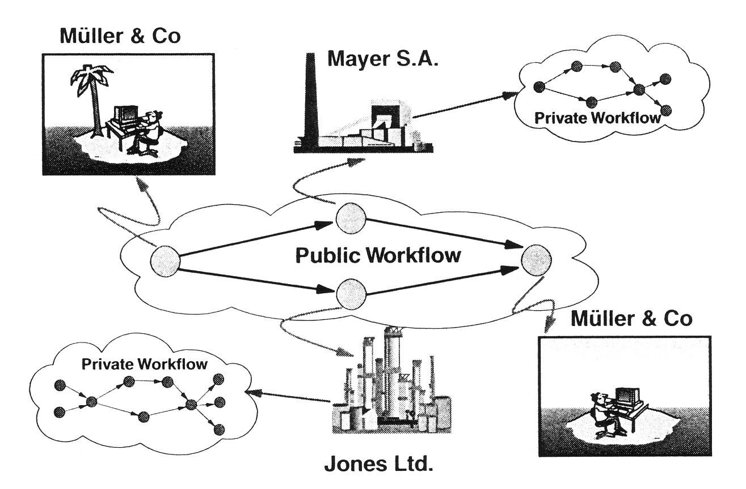
Public and Private Processes

Slide 33
Private and Public Processes in BPMN
BPMN uses Pools when representing the interaction between an organisations and participants outside of its control.
Each participant operates a separate process represented by pools.
Within a company, a single pool covers its own internal operations. It is only when it interacts with external participants that additional pools are required.
Message Flow cannot communicate between Tasks inside a single Pool. This is what Sequence Flow and data flow does.
Message Flow moves the Process from one agency to another.

Slide 34
Orchestration, Choreography, and Collaboration
BPMN supports three main categories of Processes:
Orchestration
Choreography
Collaboration
Orchestration models imply a single coordinating point of view. An orchestration Process describes a process within a single business entity.
An orchestration is contained within a Pool and normally has a well-formed context.
A choreography process model is a definition of the behavior between interacting
participants.
A choreography does not exist within a well-formed context or focus of control.
There is no central mechanism that drives or keeps track of a choreography. Therefore, there are no shared data available to all the elements of the choreography.
To place choreography within BPMN diagrams is to put them between the Pools.
Collaboration shows the participants and their interactions
In BPMN a collaboration only shows Pools and the message flow between them
(White & Miers 2008, pp. 29ff)

Slide 35
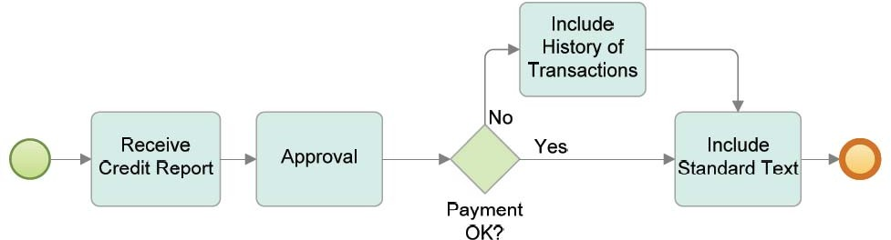
Orchestration in BPMN
A BPMN diagram may contain more than one orchestration. If so, each orchestration appears within its own container called a Pool. Thus, orchestrations (i.e., Processes) are always contained within a Pool.
(White & Miers 2008, p. 29)

Slide 36
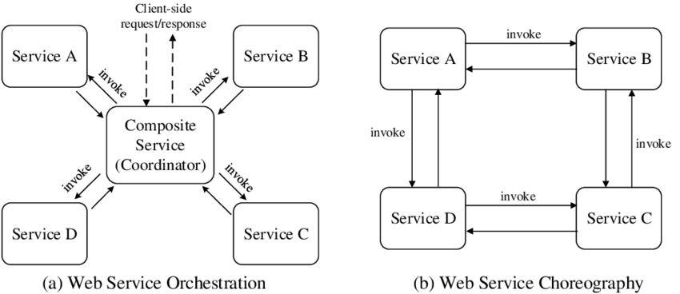
process orchestration vs choreography
The term Process Conversation refers to the concrete messages that are ex-changed as specified in a given process choreography. Therefore, process choreographies serve as conversation models.

Slide 37
Process Choreography
Choreographies have a central role in ensuring interoperability between process orchestrations.
It is performed by a participant in a business-to-business collaboration.
Several industry initiatives are in place for establishing standardized choreographies in particular domains.
Examples: include RosettaNet for the supply chain domain, SWIFTNet for financial services, and Health Level Seven (HL7) for health care services.
They all define rules for the collaboration that companies need to comply with in order to collaborate with each other.

Slide 38
Process Choreography
By introducing collaboration rules, costs for the individual companies are reduced.
New companies can join the market more easily, since they know the rules of that domain.
These collaboration rules are specified by process choreographies.

Slide 39
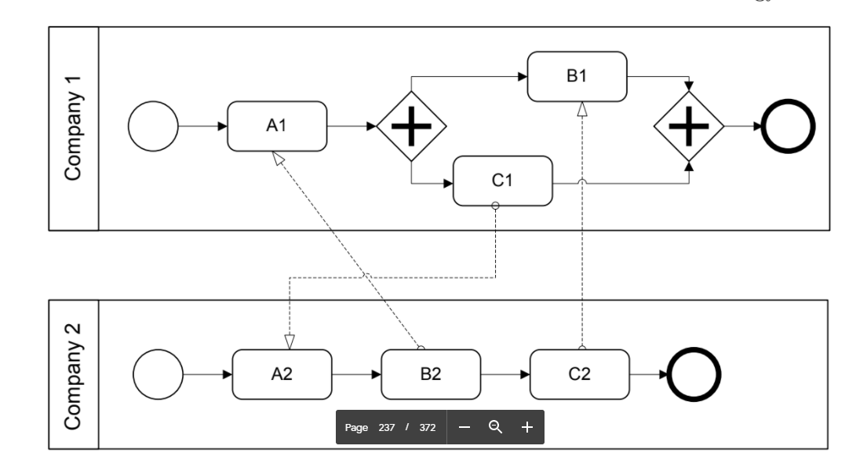
Process Choreography
The first activity to be performed by Company 1 is receive activity A1.This activity waits to receive a message sent by activity B2. the receive activity A1 is blocking, the process orchestration run by Company 1 cannot proceed. Company 2 waits in activity A2 to receive a message from activity C1 to be sent by Company 1. As a result, both process orchestrations
cannot proceed: they are stuck in a permanent deadlock situation.
To avoid these kinds of problems, the partners involved in a process choreography need
to agree on the process choreography.

Slide 40
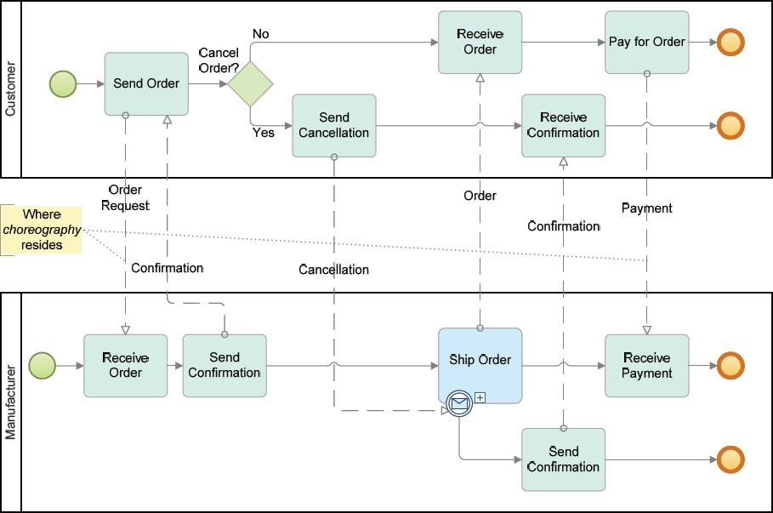
Choreography Example

Slide 41
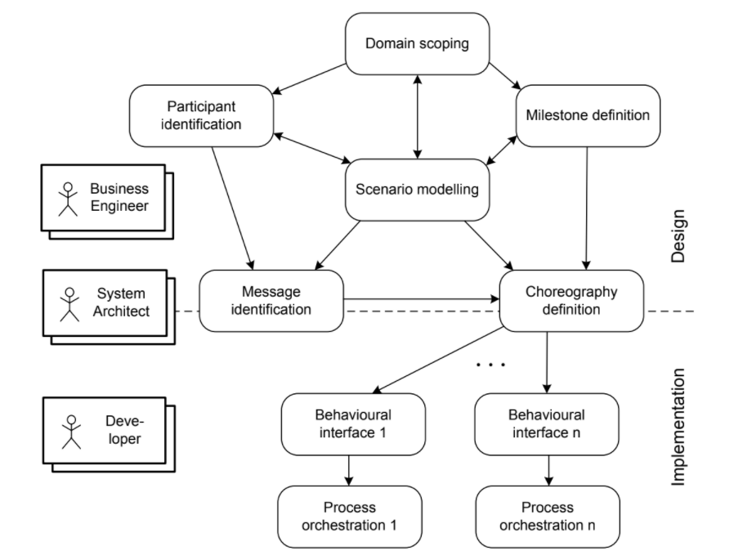
The phases involved in the development of process choreographies
There are three associated roles that represent the stakeholders involved in choreography design and implementation.

Slide 42
Business Engineers
Business engineers are mainly involved in the choreography design phases including:
scenario modelling--Plan
domain scoping--what users can and cannot access
milestone definition--Goals
participant identification
Business engineers are responsible for business-related aspects of the process choreography; they need to make sure that the collaboration contributes to the goals of the enterprise, similarly to organizational business processes.

Slide 43
System Architecture
System architects are responsible for the architectural aspects of the implemented process choreography.
System architects are at the border of design and implementation,

Slide 44
Process Choreography Design
High-level Structure Design:
High-level Behavioral Design:
Collaboration Scenarios:
Behavioral Interfaces:

Slide 45
Problem Statement
Auctioning brings together a seller and a buyer. The seller owns a certain good or offers a certain service. There are a number of potential buyers interested in the same item offered. The auctioning mechanism determines the actual buyer by allowing bidders (the potential buyers) to place bids. The auction has a predefined timeframe, e.g. several days. Only during the auction, the bidders are allowed to place their bids. The seller might define a minimum bid and there might be a fixed bidding increment depending on the currently highest bid and the policies of the auctioning service. Once the auction is over, the bidder who has placed the highest bid wins and follow-up activities such as payment and delivery are initiated.

Slide 46
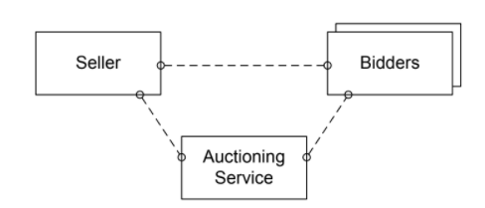
High-Level Design-Structural
High-level process choreography design involves structure design and behaviour design.
In high-level structure design, participant roles of the choreography are defined,

Slide 47
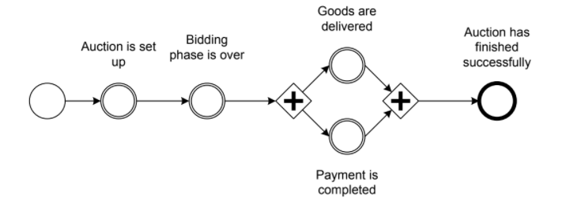
High-Level Design-Behaviour
High-level process choreography design involves structure design and behaviour design.
High-level behaviour design uses milestones that are achieved during the collaboration;
Each milestone represents a state in the overall collaboration that has a business meaning.
Initial Goal
Intermediate Goal
Ultimate Goal
milestones are defined by circles,
where the initial milestone has a single border.
the intermediate milestones have double borders, and the ultimate goal milestone has a bold border.

Slide 48
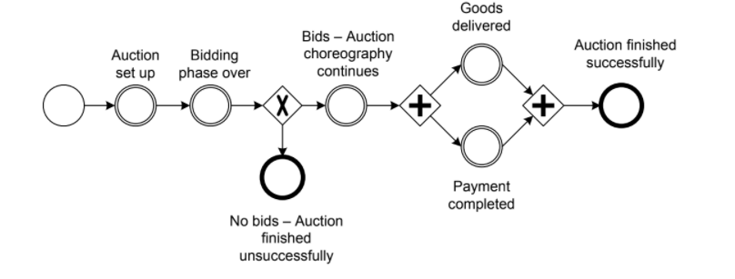
High-level behavioural model for bidding scenario, with different outcomes
if no single bid is placed during the auction. In this case, delivery and payment cannot
occur, and the conversation ends without the final goal being reached.

Slide 49
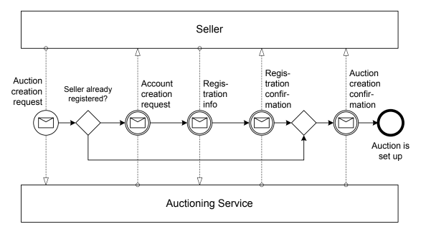
Collaboration Scenarios
In this phase, the interactions needed to proceed from one milestone to another are specified.
Interactions between process participants serve as the building blocks for the resulting collaboration scenarios.
Collaboration scenario: reaching milestones through interactions

Slide 50
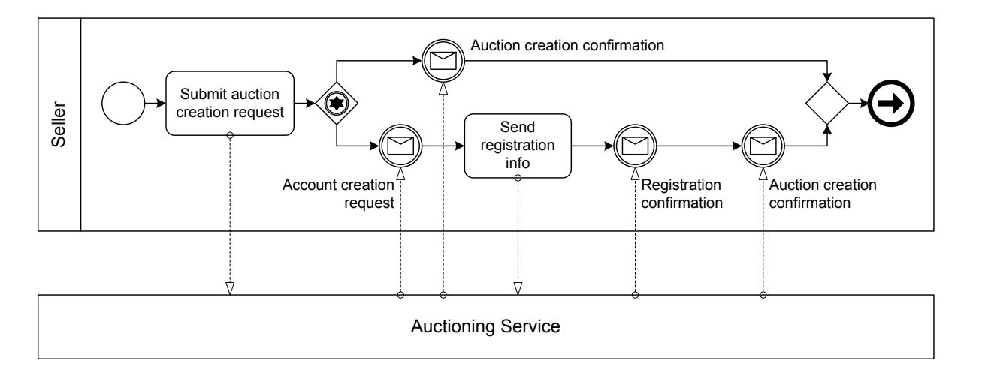
4. Behavioral interface for seller
A behavioural interface covers the individual view of one specific participant in the process choreography;
Behavioral interfaces consider parts of process orchestrations

Slide 51
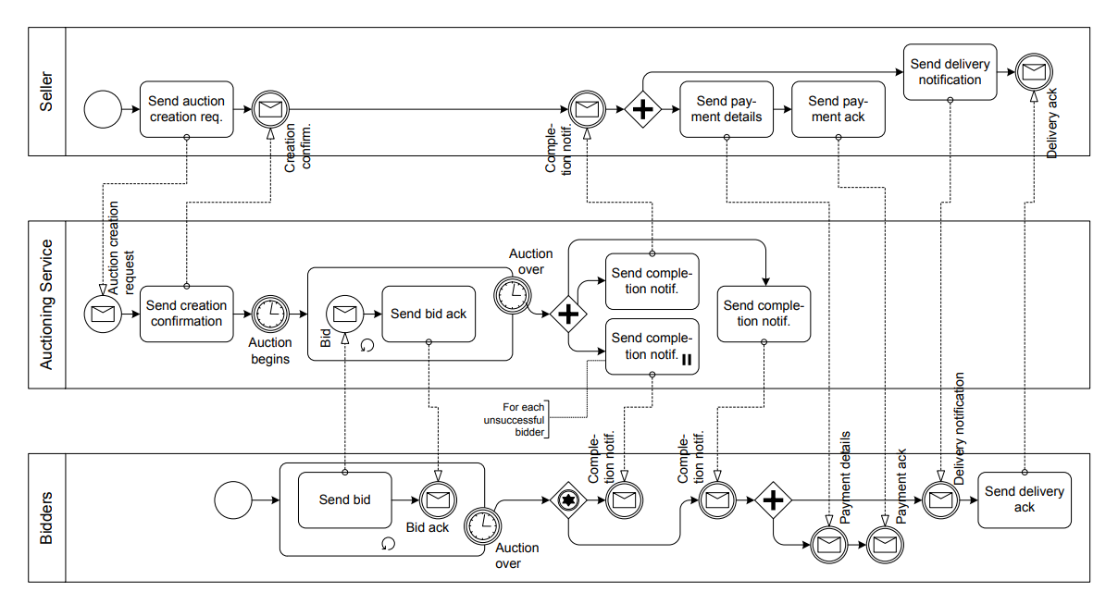
Summary- model for bidding scenario,
Behavioral-Interface of seller
Behavioral-Interface of Auction
Structural-Participant
Behavioral-Interface of Bidder
Behavioral-Participant

Slide 52
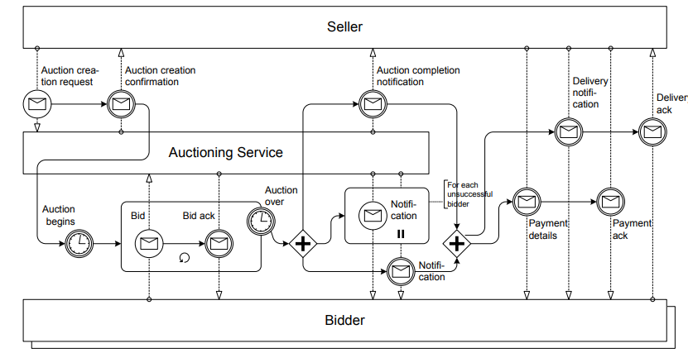
Interaction Model/collabration

Slide 53
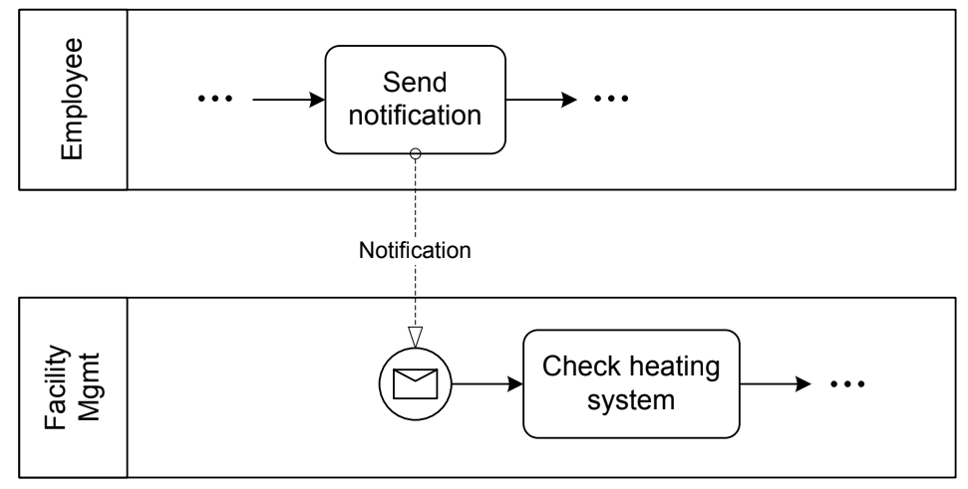
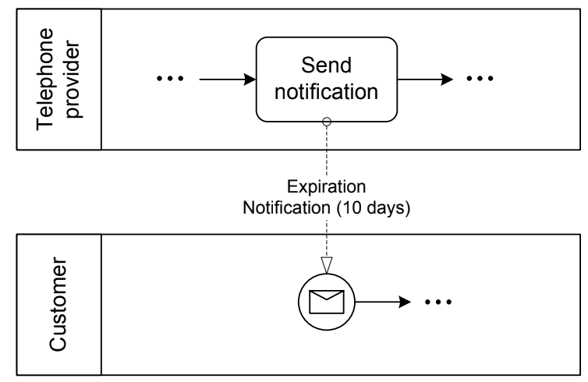
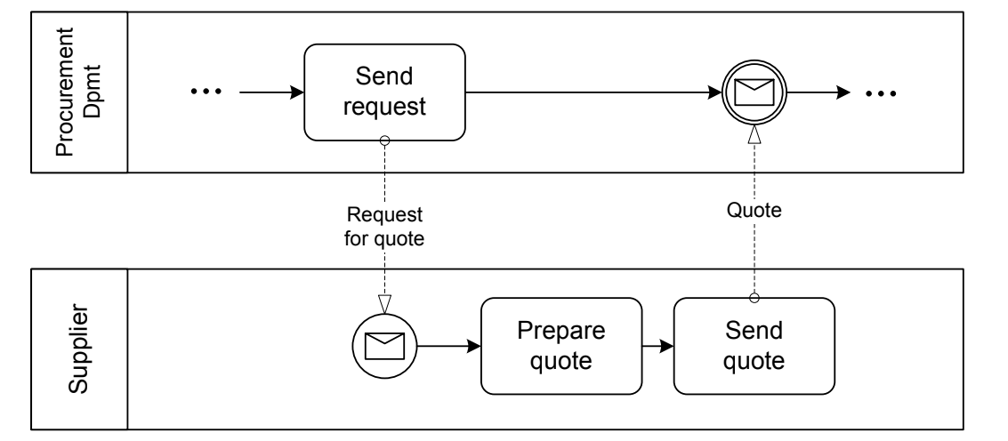
Service Interaction Patterns
Recive: from perspective of the Receiver.
Send: from perspective of the sender.
Send/Receive

Slide 54
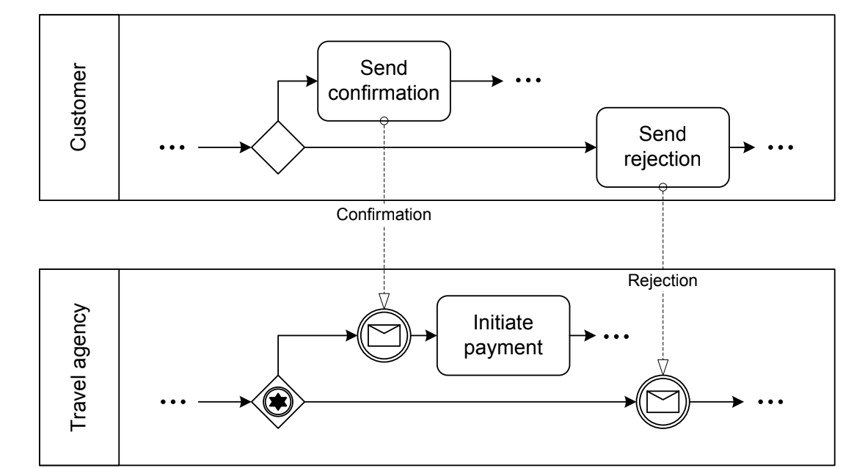
Racing Incoming Messages
Racing incoming messages are common in business-to-business scenarios; this pattern is described as follows: a participant is waiting for a message to arrive, but other participants have the chance to send a message. These messages by different participants “race” with each other. Only the first message arriving
will be processed.
Figure 5.21 shows a scenario where a travel agent has reserved a flight for
a customer, and now waits for a confirmation or a notification that the flight
details are not acceptable. In the case of confirmation the payment is initiated,
and in the case of rejection a new flight reservation might be needed.

Slide 55
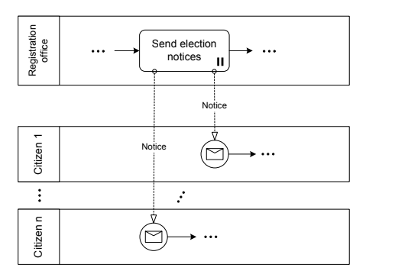
One-To-Many Send
A participant sends out several messages to other participants in parallel.

Slide 56
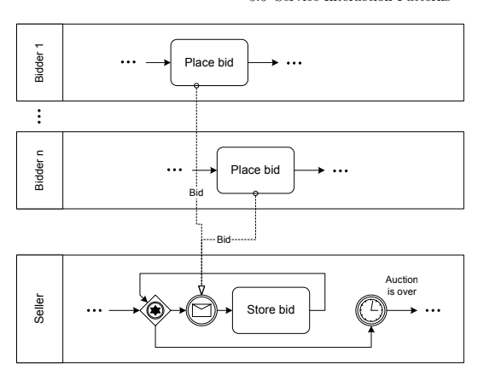
One-From-Many Receive
In the one-from-many receive pattern, messages can be received from many
participants. In

Slide 57
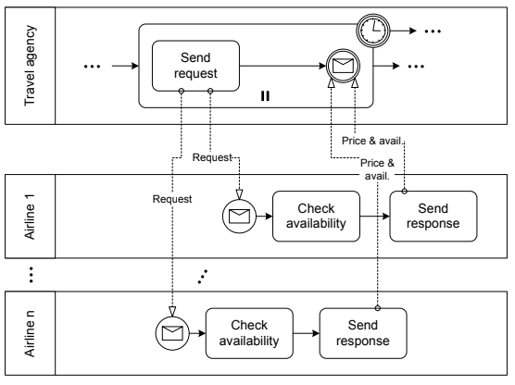
One-To-Many Send/Receive
A travel agency looks for the best offer for a flight on a certain route. The agent therefore initiates requests and the airlines give their prices and current
availability,

Slide 58
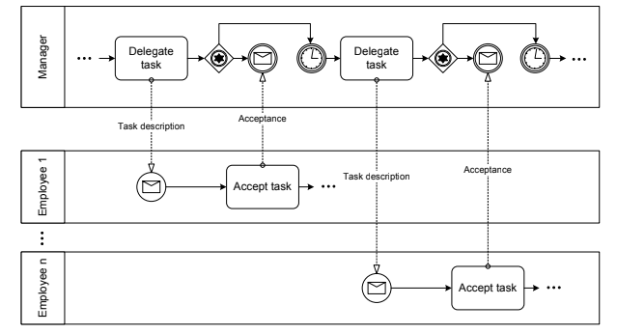
contingent requests patter
a participant sends a request to another
participant. If this participant does not answer within a given time, the request
is sent to a second participant. Again, if no response comes back, a third
participant is contacted, and so on. Delayed responses, i.e., responses arriving
after the time-out has already occurred, might or might not be discarded.

